Slide 1
Building a Shipping Form

Slide 2
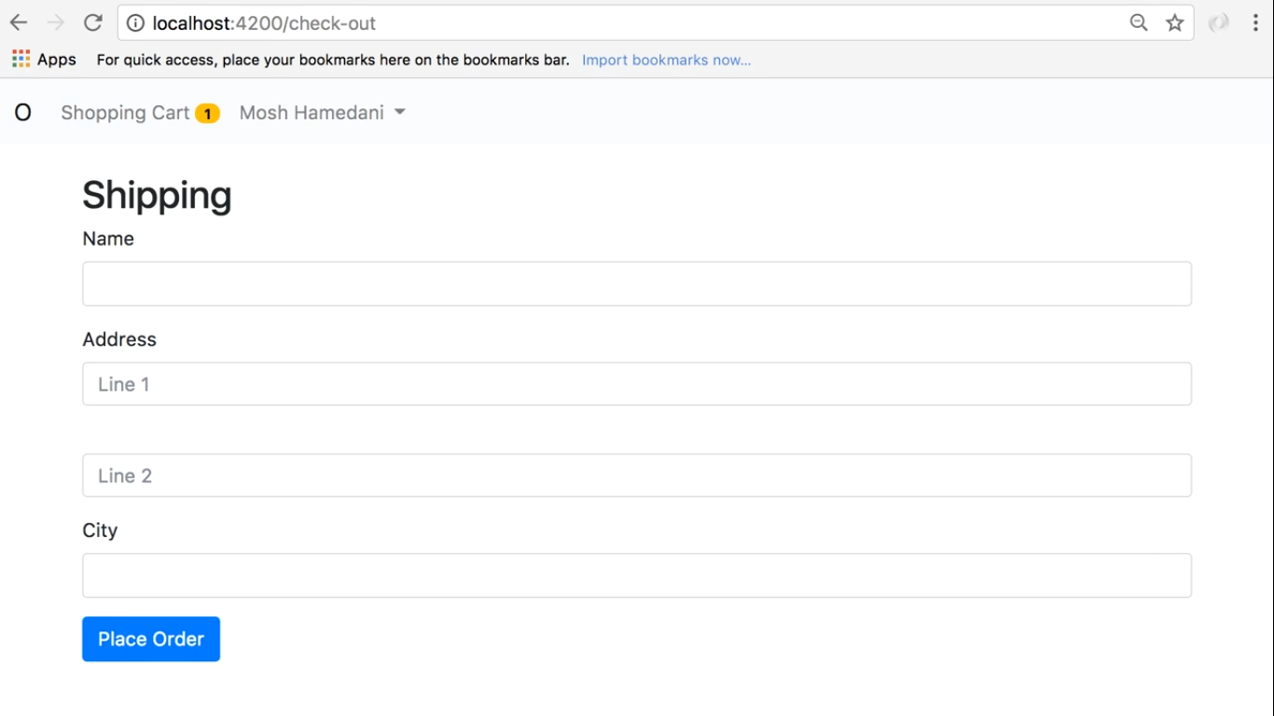

Slide 3
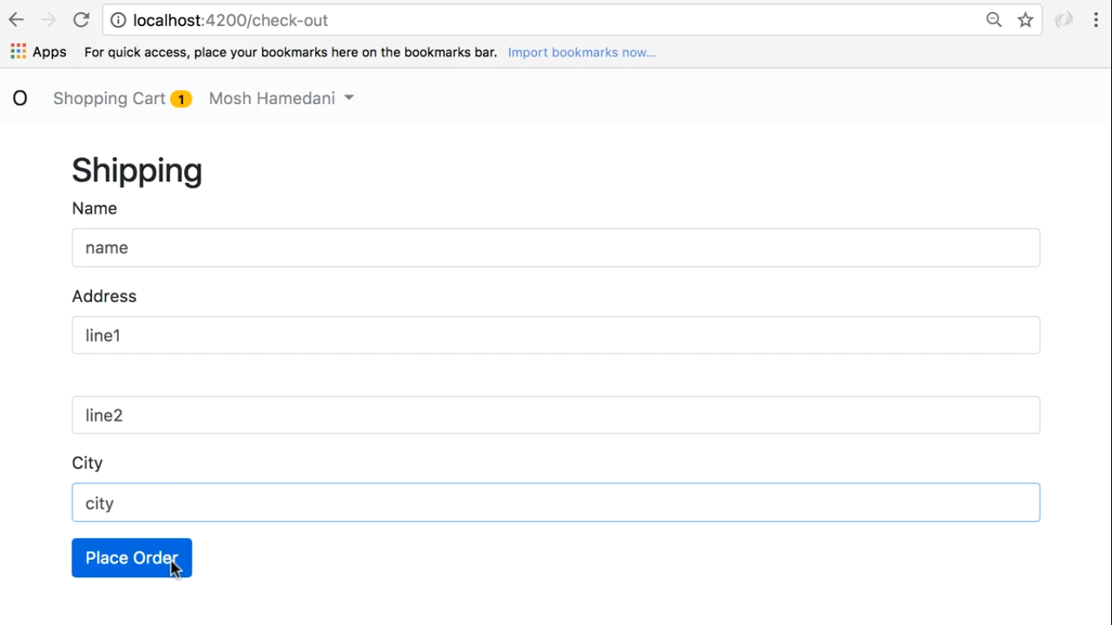

Slide 4
